Slide 1


Workshop Facilitator: Marina Zervou
*Views and opinions expressed are however those of the author(s) only and do not necessarily reflect those of the European Union or the European Education and Culture Executive Agency (EACEA). Neither the European Union nor EACEA can be held responsible for them.

Slide 2
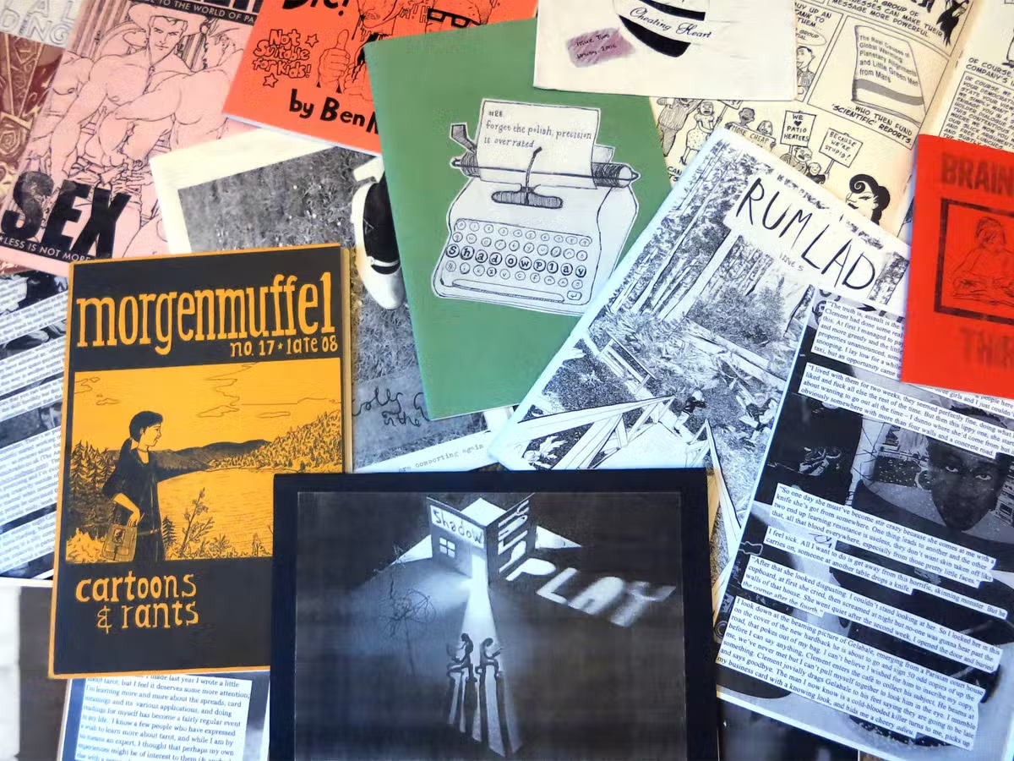
A fanzine (blend of fan and magazine or -zine) is a non-professional, non-official and low cost publication produced by enthusiasts of a particular cultural genre, like literature, music and art, in order to share and communicate in a creative way their interest with others.
The term was coined in an October 1940 science fiction fanzine by Russ Chauvenet and first popularized within science fiction fandom, and from there it was adopted by other communities.

Slide 3



Fanzines are self-published, small circulation magazines that cover a wide spectrum of ideas not written in a style found in conventional media.
Fanzines are put together in a chaotic fashion and they may include texts, poetry, art experiments, articles, thoughts and comments.

Slide 4
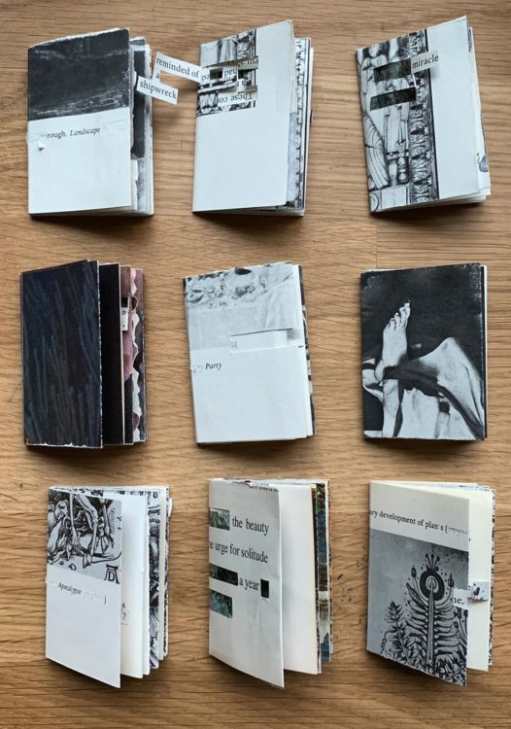

While rarely intended for the mainstream, fanzines are now considered an important part of world culture, and several pillars of academia — including Duke, Harvard, University of Arizona, University of Meryland and University of Iowa – have fanzine collections.

Slide 5
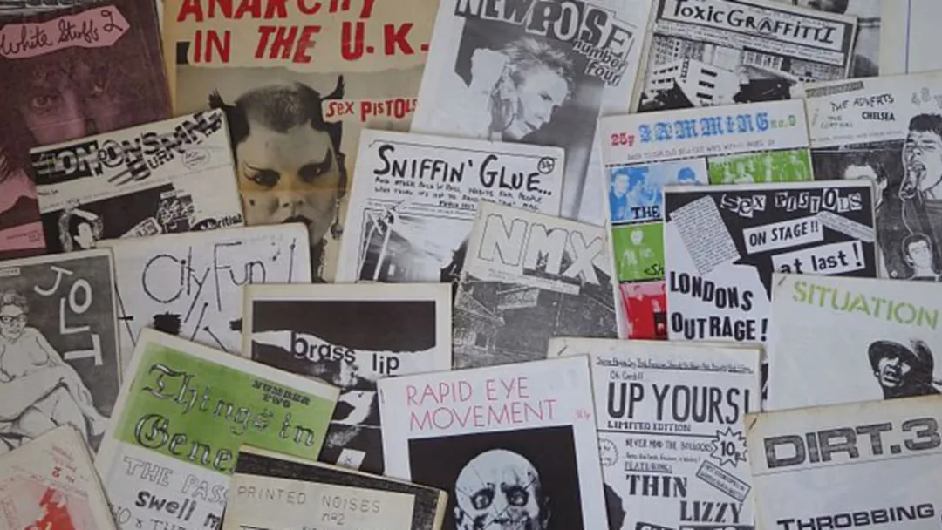
Fanzines were originally devoted to chronicling people’s interest in literary science fiction, but over the course of the 20th (and into the 21st) century, they have been adopted as vehicles of personal and cultural expression by a number of new fan communities.
The usefulness of zines as historical documents is now being recognized.
Many universities have their own zine collections and there are also numerous independent zine libraries both in America and around the world.

Slide 6

People are still producing fanzines but there aren’t nearly as many as there were in years past.
Their decline is largely due to the advent of the internet which has made content creation simpler, distribution fast and cheap, while also allowing for easy interaction between readers and online publishers.

Slide 7
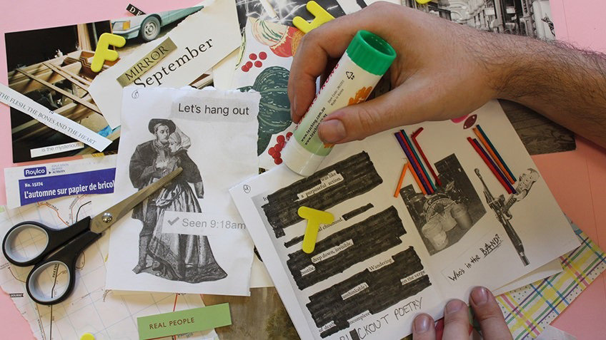
A Fanzine usually is made from found images, drawings and text (hand written or printed), like a collage, therefore it enables experimentation and creativity.
Τext and image, put together in an unconvetional, unrestricted
way, extend the ways we perceive literature and/or art,
widening the horizons of our understanding and consciousness.

Slide 8

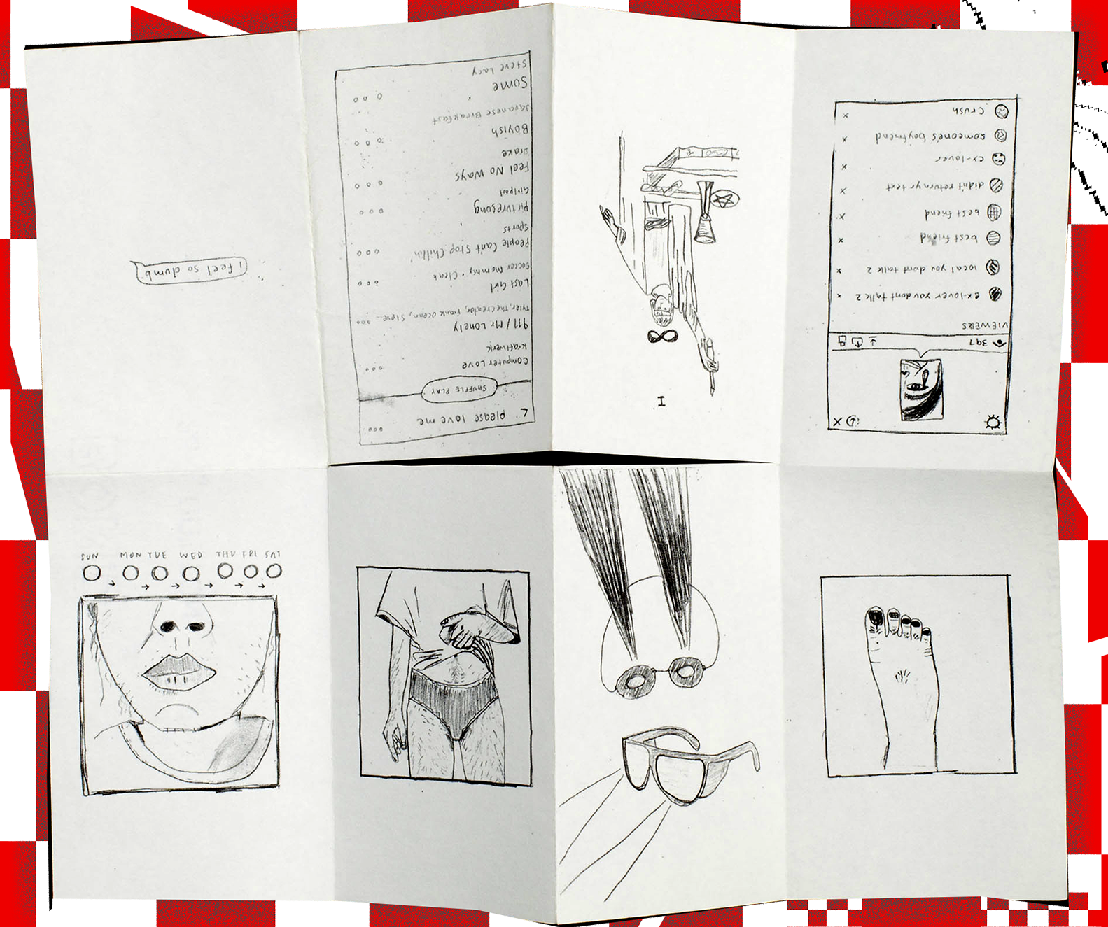


Slide 9
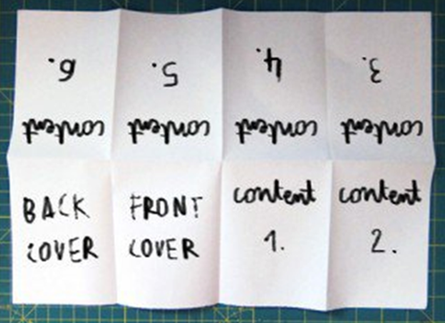
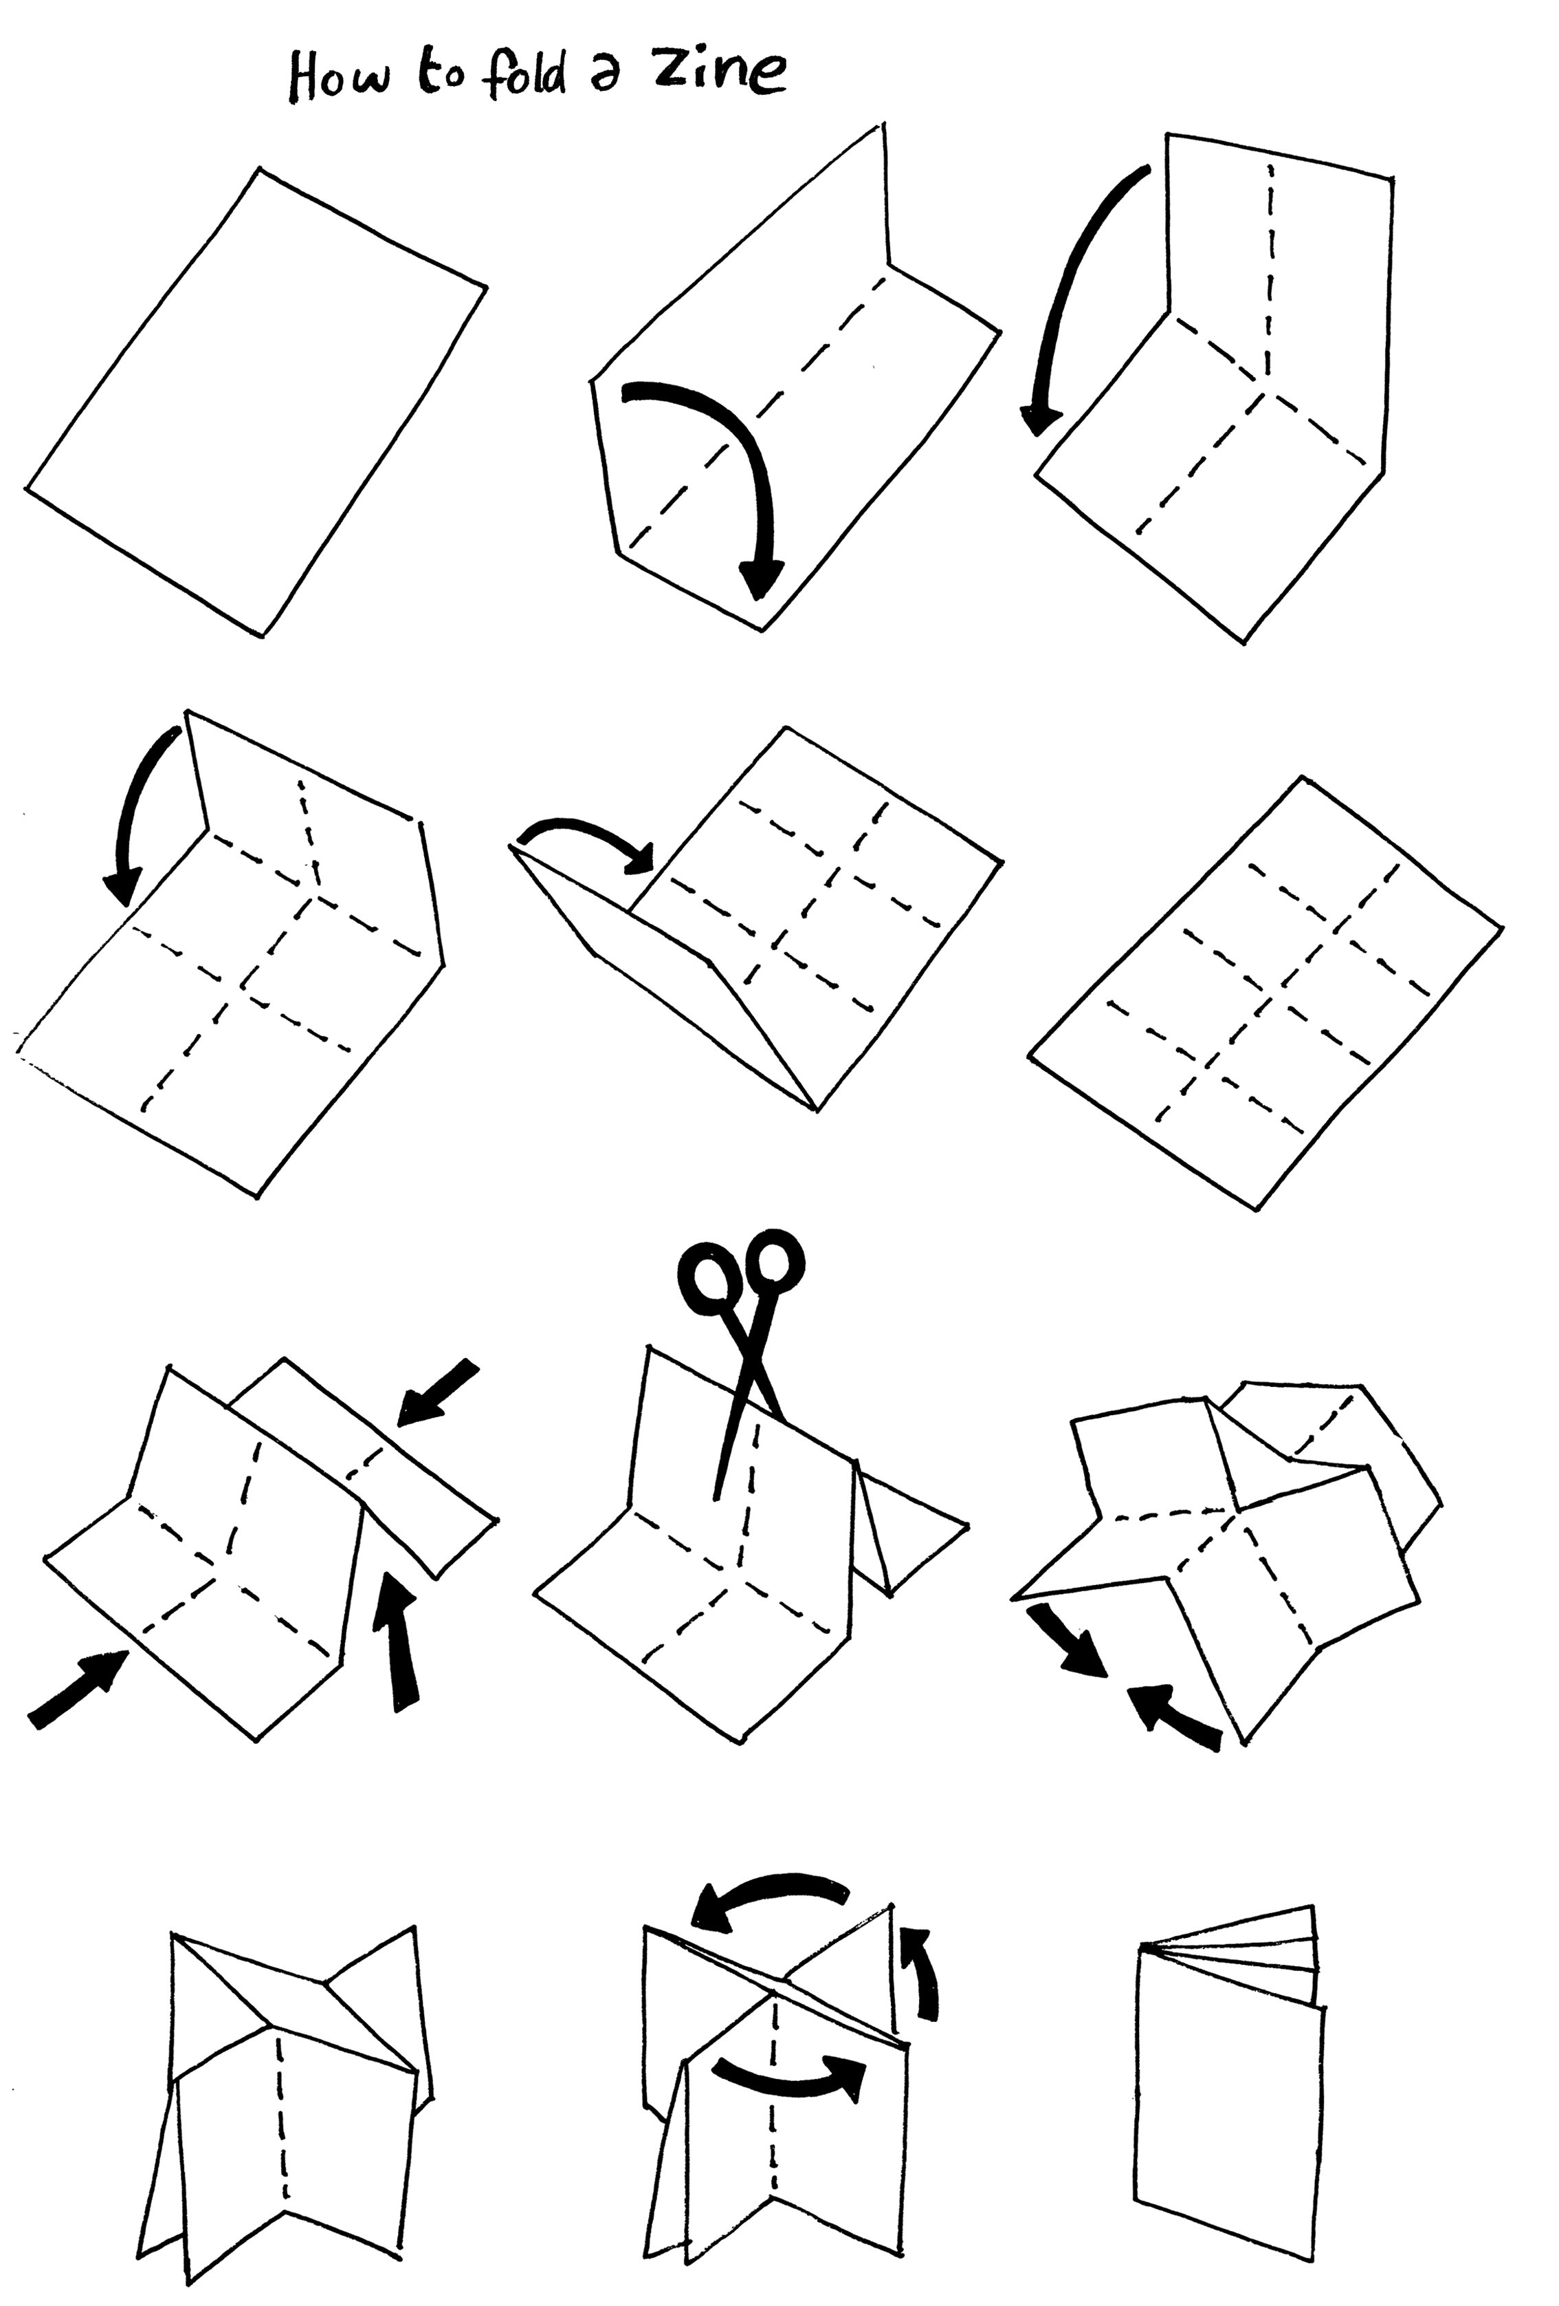
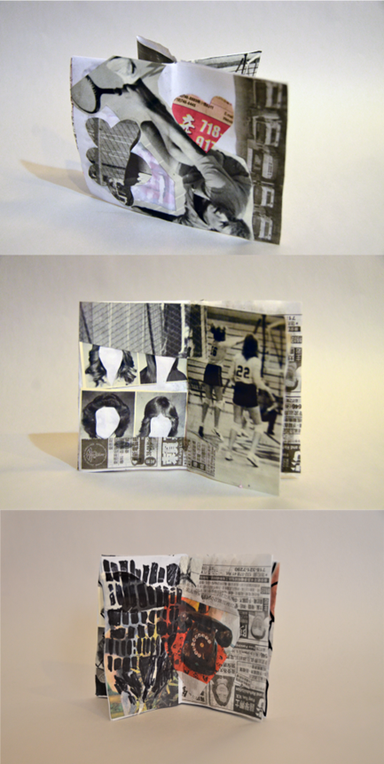


Slide 10
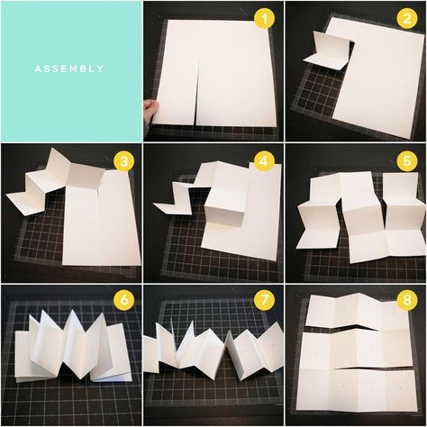

Slide 11
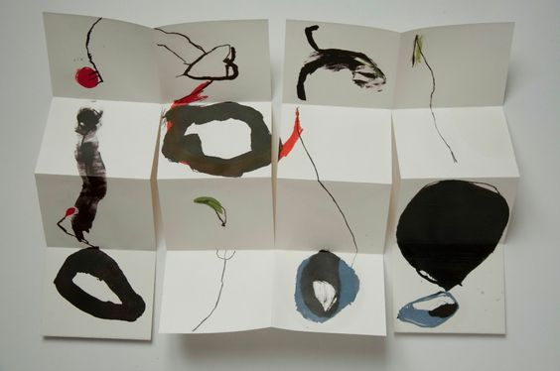

Slide 12
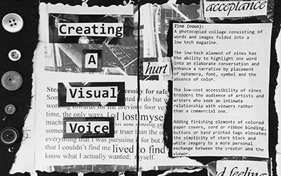
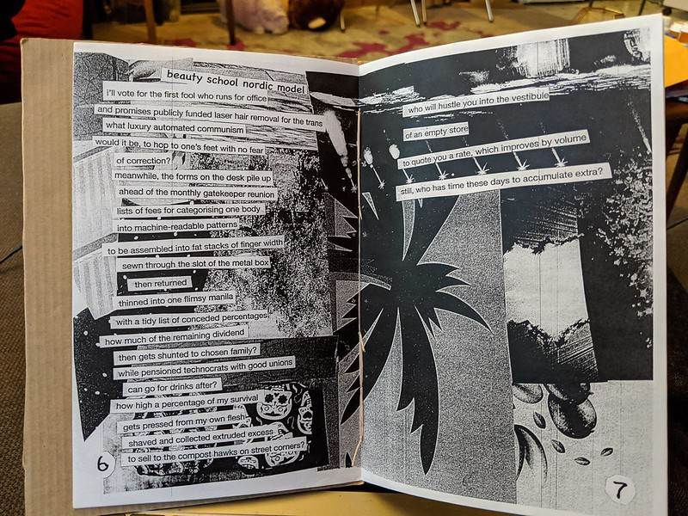



Slide 13
https://archives.lib.duke.edu/catalog/murrayzine
https://digital.lib.umd.edu/results?index1=dmKeyword&query1=fanzine
https://blogs.harvard.edu/houghtonmodern/2014/07/11/fanzines-of-the-southern-apas/
https://speccoll.library.arizona.edu/collections/anthony-boucher-fanzine-collection
https://www.mentalfloss.com/article/88911/brief-history-zines
https://brokenpencil.com/about/
https://thecreativeindependent.com/guides/how-to-make-a-zine/
https://melissaflemingblog.wordpress.com/2015/10/21/what-is-a-zine/
https://www.youtube.com/watch?v=oiqQrVrW9XY
https://www.youtube.com/watch?v=kMOGGY4tqXE

Slide 14

Thank you!
*Views and opinions expressed are however those of the author(s) only and do not necessarily reflect those of the European Union or the European Education and Culture Executive Agency (EACEA). Neither the European Union nor EACEA can be held responsible for them.

